Slide 1

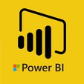
Hii,
Iam Siddhika
Welcome to Power BI Series
Part -63

Slide 2



I’m very excited to dive into this with you all!
Are you ready to enhance your data visualization skills?
We focus only on the most used and important Visuals
Today Content
VISUALIZING DATA
VISUALS - CHANGE OVER TIME
COMBO CHART VISUALS - FLOW FUNNEL CHART

Slide 3
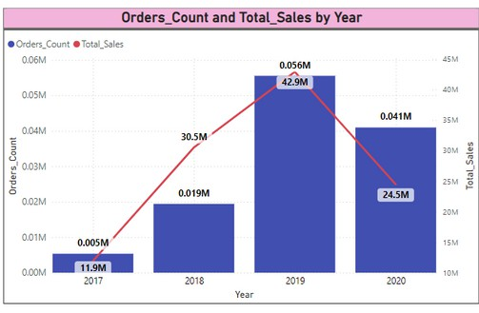

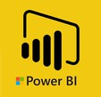
COMBO CHART
A Combo Chart is a single visualization that combines a line chart and a column chart. Combining the two charts into one lets you make quicker comparisons of the data.
check next slide
for stacked and
cluster of line and
column charts
Key Features:
Dual Y-Axis: Can one or two Y-axes.
have
Combined View: Shows both detailed and overall trends in one visual.
When to Use: Same X-Axis: When you have a line chart and a column chart with the same X-axis.
Different Value Ranges: To compare multiple measures with different value ranges.
Correlation: To illustrate the correlation between two measures in one visualization.
Target vs. Actual: To check whether one measure meets the target defined by another measure.
Space Efficiency: To conserve canvas space.

Slide 4
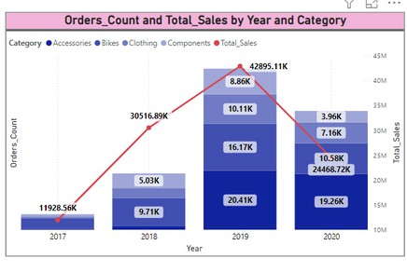
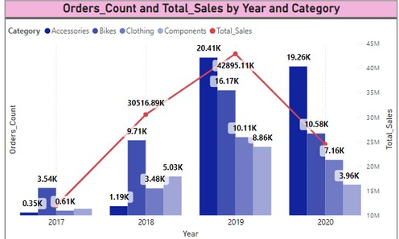

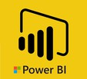
COMBO CHARTS
Go and explore formatting of these Charts
Line and stacked Column Chart
Line and clustered Column Chart
Practical Tips
Dual Y-Axis: Use dual Y-axis to handle different scales, ensuring both columns and line are visible.
Legend and Data Labels: Add a legend for categories and data labels for precise values.
Interactivity: Use drill-down and tooltips to explore data deeper.

Slide 5
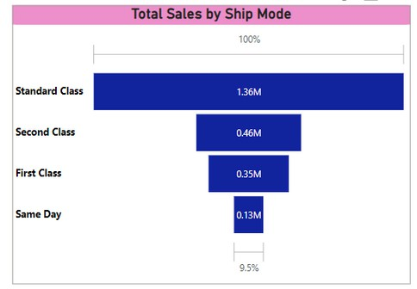

FUNNEL CHART
Go and explore formatting of Funnel Chart
A Funnel Chart is a type of visual that shows the flow of a process through different stages. It visually represents the reduction of data as it progresses through each stage of a process.
Key Features:
Stages: Each stage in the funnel represents a part of the process.
Data Reduction: Shows how data is reduced at each stage.
Visual Flow: Highlights bottlenecks and drop-off points in a process.
When to Use: Sales Pipeline: To visualize stages in a sales process from leads to closed sales.
Conversion Rates: To show the conversion rates at each step of a marketing campaign.
Process Analysis: To analyze steps in a business process or workflow.
Customer Journey:To illustrate the customer journey from initial contact to final purchase. etc.

Slide 6


Thank you for joining me today to learn about Part -63 of Power BI!
Remember, Effective data visualization is crucial for turning data into meaningful insights and compelling narratives with Power BI.
Stay tuned for more insights and tips on Power BI in our next Series.
Follow
Siddhika Shah

